Slide 1
Flow of Control

Slide 2
Agenda
iii. For Loop
▪ Initilizationsection
▪ Conditional check
▪ Increment and decrement section
▪ Unreachable statement in for loop
iv. For each
▪ Iterator Vs Iterable(1.5v)
▪ Difference between Iterable and Iterator
4. Transfer statements
o Break statement
o Continue statement
o Labeled break and continue statements
o Do-while vs continue (The most dangerous combination)
1. Introduction
2. Selection statements
i. if-else
ii. Switch
▪ Case Summary
▪ fall-through inside a switch
▪ default case
3. Iterative Statements
i. While loop
▪ Unreachable statement in while
ii. Do-while
▪ Unreachable statement in do while

Slide 3
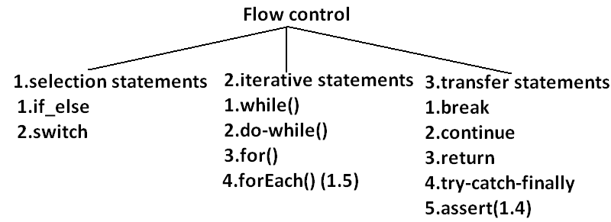
Flow control describes the order in which all the statements will be executed at run
time.
87

Slide 4
Selection statements
if-else

Slide 5
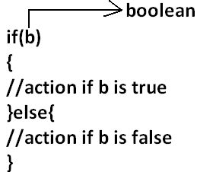
Syntax
The argument to the if statement should be Boolean by mistake if we are providing any other type we will get "compile time error".
87

Slide 6
Example 1:
public class ExampleIf{
public static void main(String args[]){
int x=0;
if(x)
{
System.out.println("hello");
}else{
System.out.println("hi");
}}}
OUTPUT:
Compile time error:
D:\Java>javac ExampleIf.java
ExampleIf.java:4: incompatible types
found : int
required: boolean
if(x)
Example 2:
public class ExampleIf{
public static void main(String args[]){
int x=10;
if(x=20)
{
System.out.println("hello");
}
else{
System.out.println("hi");
}}}
OUTPUT:
Compile time error
D:\Java>javac ExampleIf.java
ExampleIf.java:4: incompatible types
found : int
required: boolean
if(x=20)
88

Slide 7
Example 4:
public class ExampleIf{
public static void main(String args[]){
boolean b=false;
if(b=true)
{
System.out.println("hello");
}else{
System.out.println("hi");
}}}
OUTPUT:
Hello
Example 5:
Example 3:
public class ExampleIf{
public static void main(String args[]){
int x=10;
if(x==20)
{
System.out.println("hello");
}else{
System.out.println("hi");
}}}
OUTPUT:
Hi
public class ExampleIf{
public static void main(String args[]){
boolean b=false;
if(b==true)
{
System.out.println("hello");
}else{
System.out.println("hi");
}}}
OUTPUT:
Hi

Slide 8
Example 7:
public class ExampleIf{
public static void main(String args[]){
if(true);
}}
OUTPUT:
No output
Both else part and curly braces are optional.
Without curly braces we can take only one statement under if, but it should not be
declarative statement.
Example 6:
public class ExampleIf{
public static void main(String args[]){
if(true)
System.out.println("hello");
}}
OUTPUT:
Hello
Example 8:
public class ExampleIf{
public static void main(String args[]){
if(true)
int x=10;
}}
OUTPUT:
Compile time error
D:\Java>javac ExampleIf.java
ExampleIf.java:4: '.class' expected
int x=10;
ExampleIf.java:4: not a statement
int x=10;
89

Slide 9
Example 8:
public class ExampleIf{
public static void main(String args[]){
if(true)
int x=10;
}}
OUTPUT:
Compile time error
D:\Java>javac ExampleIf.java
ExampleIf.java:4: '.class' expected
int x=10;
ExampleIf.java:4: not a statement
int x=10;
Example 9:
public class ExampleIf{
public static void main(String args[]){
if(true){
int x=10;
}}}
OUTPUT:
D:\Java>javac ExampleIf.java
D:\Java>java ExampleIf
89

Slide 10
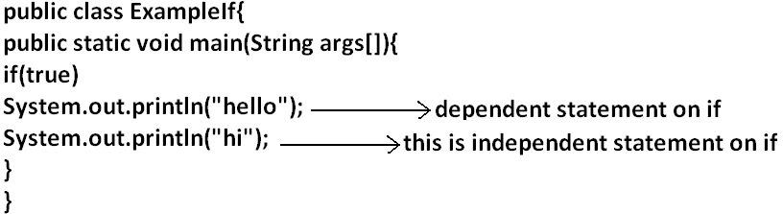
Example 10:
OUTPUT:
Hello
Hi
Semicolon(;) is a valid java statement which is call empty statement and it won't
produce any output.
89

Slide 11
Switch

Slide 12
If several options are available then it is not recommended to use if-else we should go
for switch statement.Because it improves readability of the code.
Syntax:
switch(x)
{
case 1:
action1
case 2:
action2
.
.
.
default:
default action
}
Until 1.4 version the allow types for the switch argument are byte, short, char, int but
from 1.5 version on wards the corresponding wrapper classes (Byte, Short, Character,
Integer) and "enum" types also allowed.
90

Slide 13
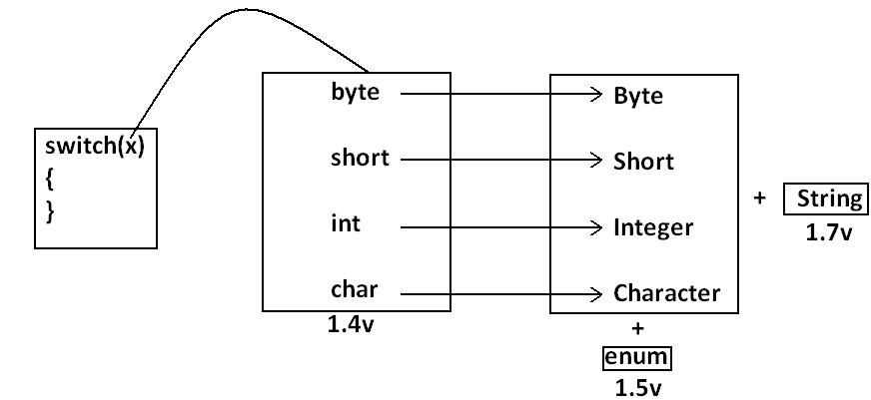
• Curly braces are mandatory.(except switch case in all remaining cases curly
braces are optional )
• Both case and default are optional.
• Every statement inside switch must be under some case (or) default. Independent
statements are not allowed.
91

Slide 14
Example 2:
public class ExampleSwitch{
public static void main(String args[]){
int x=10;
int y=20;
switch(x)
{
case 10:
System.out.println("10");
case y:
System.out.println("20");
}}}
OUTPUT:
Compile time error
D:\Java>javac ExampleSwitch.java
ExampleSwitch.java:9: constant expression required
case y:
If we declare y as final we won't get any compile time error
Example 1:
public class ExampleSwitch{
public static void main(String args[]){
int x=10;
switch(x)
{
System.out.println("hello");
}}}
OUTPUT:
Compile time error.
D:\Java>javac ExampleSwitch.java
ExampleSwitch.java:5: case, default, or '}' expected
System.out.println("hello");
Every case label should be "compile time constant" otherwise we will get compile time
error.
91

Slide 15
Example 3:
public class ExampleSwitch{
public static void main(String args[]){
int x=10;
final int y=20;
switch(x)
{
case 10:
System.out.println("10");
case y:
System.out.println("20");
}}}
OUTPUT:
10
20
But switch argument and case label can be expressions , but case label should be
constant expression.
Example 4:
public class ExampleSwitch{
public static void main(String args[]){
int x=10;
switch(x+1)
{
case 10:
case 10+20:
case 10+20+30:
}}}
OUTPUT:
No output.
Every case label should be within the range of switch argument type.
92

Slide 16
Example 5:
public class ExampleSwitch{
public static void main(String args[]){
byte b=10;
switch(b)
{
case 10:
System.out.println("10");
case 100:
System.out.println("100");
case 1000:
System.out.println("1000");
}}}
OUTPUT:
Compile time error
D:\Java>javac ExampleSwitch.java
ExampleSwitch.java:10: possible loss of precision
found : int
required: byte
case 1000:
Example :
public class ExampleSwitch{
public static void main(String args[]){
byte b=10;
switch(b+1)
{
case 10:
System.out.println("10");
case 100:
System.out.println("100");
case 1000:
System.out.println("1000");
}}}
OUTPUT:
Duplicate case labels are not allowed.
92

Slide 17
Example 6:
public class ExampleSwitch{
public static void main(String args[]){
int x=10;
switch(x)
{
case 97:
System.out.println("97");
case 99:
System.out.println("99");
case 'a':
System.out.println("100");
}}}
OUTPUT:
Compile time error.
D:\Java>javac ExampleSwitch.java
ExampleSwitch.java:10: duplicate case label
case 'a':
93

Slide 18
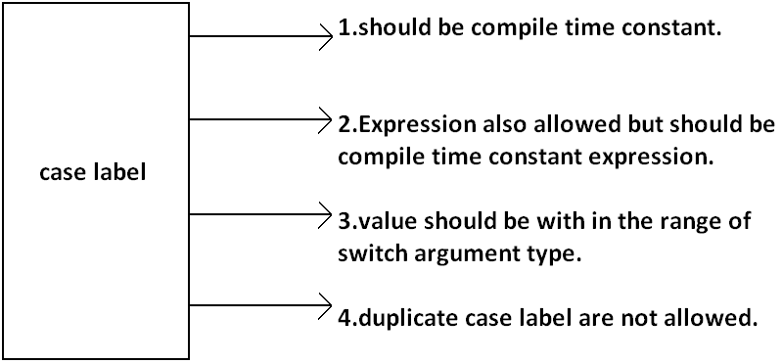
CASE SUMMARY
93

Slide 19
FALL-THROUGH INSIDE THE SWITCH

Slide 20
With in the switch statement if any case is matched from that case onwards all
statements will be executed until end of the switch (or) break. This is call "fall-through"
inside the switch .
The main advantage of fall-through inside a switch is we can define common action for
multiple cases
case 0:
System.out.println("0");
case 1:
System.out.println("1");
break;
case 2:
System.out.println("2");
default:
System.out.println("default");
}}}
OUTPUT:
x=0 x=1 x=2 x=3
0 1 2 default
1 default
Example 7:
public class ExampleSwitch{
public static void main(String args[]){
int x=0;
switch(x)
{
94

Slide 21
DEFAULT CASE
case 1:
System.out.println("1");
case 2:
System.out.println("2");
}}}
OUTPUT:
X=0 x=1 x=2 x=3
0 1 2 default
2 0
• With in the switch we can take the default only once
• If no other case matched then only default case will be executed
• With in the switch we can take the default any where, but it is convension to take
default as last case.
Example 8:
public class ExampleSwitch{
public static void main(String args[]){
int x=0;
switch(x)
{
default:
System.out.println("default");
case 0:
System.out.println("0");
break;

Slide 22
ITERATIVE STATEMENTS
While loop

Slide 23
if we don't know the no of iterations in advance then best loop is while loop:
Example 1:
while(rs.next())
{
}
Example 2:
while(e.hasMoreElements())
{
----------
----------
----------
}
Example 3:
while(itr.hasNext())
{
----------
----------
----------
}
The argument to the while statement should be Boolean type. If we are using any other
type we will get compile time error.
Example 1:
public class ExampleWhile{
public static void main(String args[]){
while(1)
{
System.out.println("hello");
}}}
OUTPUT:
Compile time error.
D:\Java>javac ExampleWhile.java
ExampleWhile.java:3: incompatible types
found : int
required: boolean
while(1)
Curly braces are optional and without curly braces we can take only one statement
which should not be declarative statement
95

Slide 24
Example 2:
public class ExampleWhile{
public static void main(String args[]){
while(true)
System.out.println("hello");
}}
OUTPUT:
Hello (infinite times).
Example 4:
public class ExampleWhile{
public static void main(String args[]){
while(true)
int x=10;
}}
OUTPUT:
Compile time error.
D:\Java>javac ExampleWhile.java
ExampleWhile.java:4: '.class' expected
int x=10;
ExampleWhile.java:4: not a statement
int x=10;
Example 3:
public class ExampleWhile{
public static void main(String args[]){
while(true);
}}
OUTPUT:
No output.
96

Slide 25
Example 5:
public class ExampleWhile{
public static void main(String args[]){
while(true)
{
int x=10;
}}}
OUTPUT:
No output.
OUTPUT:
Compile time error.
D:\Java>javac ExampleWhile.java
ExampleWhile.java:7: unreachable statement
System.out.println("hi");
Example 7:
public class ExampleWhile{
public static void main(String args[]){
while(false)
{
System.out.println("hello");
}
System.out.println("hi");
}}
OUTPUT:
D:\Java>javac ExampleWhile.java
ExampleWhile.java:4: unreachable statement
{
Unreachable statement in while:
Example 6:
public class ExampleWhile{
public static void main(String args[]){
while(true)
{
System.out.println("hello");
}
System.out.println("hi");
}}
96

Slide 26
Example 8:
public class ExampleWhile{
public static void main(String args[]){
int a=10,b=20;
while(a<b)
{
System.out.println("hello");
}
System.out.println("hi");
}}
OUTPUT:
Hello (infinite times).
System.out.println("hello");
}
System.out.println("hi");
}}
OUTPUT:
Compile time error.
D:\Java>javac ExampleWhile.java
ExampleWhile.java:8: unreachable statement
System.out.println("hi");
Example 9:
public class ExampleWhile{
public static void main(String args[]){
final int a=10,b=20;
while(a<b)
{
97

Slide 27
Example 10:
public class ExampleWhile{
public static void main(String args[]){
final int a=10;
while(a<20)
{
System.out.println("hello");
}
System.out.println("hi");
}}
OUTPUT:
D:\Java>javac ExampleWhile.java
ExampleWhile.java:8: unreachable statement
System.out.println("hi");
Note:
• Every final variable will be replaced with the corresponding value by compiler.
• If any operation involves only constants then compiler is responsible to perform
that operation.
• If any operation involves at least one variable compiler won't perform that
operation. At runtime jvm is responsible to perform that operation.

Slide 28
Example 11:
public class ExampleWhile{
public static void main(String args[]){
int a=10;
while(a<20)
{
System.out.println("hello");
}
System.out.println("hi");
}}
OUTPUT:
Hello (infinite times).

Slide 29

Do-while
98

Slide 30
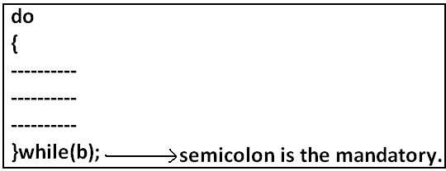
If we want to execute loop body at least once then we should go for do-while.
Syntax:
Curly braces are optional.
Without curly braces we can take only one statement between do and while and it should not be declarative statement.
98

Slide 31
Example 1:
public class ExampleDoWhile{
public static void main(String args[]){
do
System.out.println("hello");
while(true);
}}
Output:
Hello (infinite times).
Example 2:
public class ExampleDoWhile{
public static void main(String args[]){
do;
while(true);
}}
Output:
Compile successful.
Example 3:
public class ExampleDoWhile{
public static void main(String args[]){
do
int x=10;
while(true);
}}
Output:
D:\Java>javac ExampleDoWhile.java
ExampleDoWhile.java:4: '.class' expected
int x=10;
ExampleDoWhile.java:4: not a statement
int x=10;
ExampleDoWhile.java:4: ')' expected
int x=10;
99

Slide 32
Example 5:
public class ExampleDoWhile{
public static void main(String args[]){
do while(true)
System.out.println("hello");
while(true);
}}
Example 4:
public class ExampleDoWhile{
public static void main(String args[]){
do
{
int x=10;
}while(true);
}}
Output:
Compile successful.
Output:
Hello (infinite times).
Rearrange the above Example:
public class ExampleDoWhile{
public static void main(String args[]){
do
while(true)
System.out.println("hello");
while(true);
}}
Output:
Hello (infinite times).
99

Slide 33
Example 6:
public class ExampleDoWhile{
public static void main(String args[]){
do
while(true);
}}
Output:
Compile time error.
D:\Java>javac ExampleDoWhile.java
ExampleDoWhile.java:4: while expected
while(true);
ExampleDoWhile.java:5: illegal start of expression
}
Unreachable statement in do while:
Example 7:
public class ExampleDoWhile{
public static void main(String args[]){
do
{
System.out.println("hello");
}
while(true);
System.out.println("hi");
}}
Output:
Compile time error.
D:\Java>javac ExampleDoWhile.java
ExampleDoWhile.java:8: unreachable statement
System.out.println("hi");
100

Slide 34
Example 8:
public class ExampleDoWhile{
public static void main(String args[]){
do
{
System.out.println("hello");
}
while(false);
System.out.println("hi");
}}
Output:
Hello
Hi
Example 9:
public class ExampleDoWhile{
public static void main(String args[]){
int a=10,b=20;
do
{
System.out.println("hello");
}
while(a<b);
System.out.println("hi");
}}
Output:
Hello (infinite times).
100

Slide 35
Example 10:
public class ExampleDoWhile{
public static void main(String args[]){
int a=10,b=20;
do
{
System.out.println("hello");
}
while(a>b);
System.out.println("hi");
}}
Output:
Hello
Hi
Example 11:
public class ExampleDoWhile{
public static void main(String args[]){
final int a=10,b=20;
do
{
System.out.println("hello");
}
while(a<b);
System.out.println("hi");
}}
Output:
Compile time error.
D:\Java>javac ExampleDoWhile.java
ExampleDoWhile.java:9: unreachable statement
System.out.println("hi");
101

Slide 36
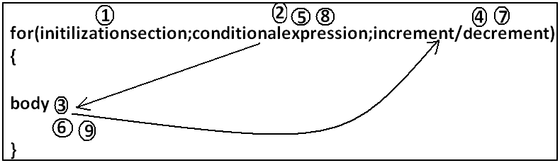
Example 12:
public class ExampleDoWhile{
public static void main(String args[]){
final int a=10,b=20;
do
{
System.out.println("hello");
}
while(a>b);
System.out.println("hi");
}}
Output:
D:\Java>javac ExampleDoWhile.java
D:\Java>java ExampleDoWhile
Hello
Hi
For Loop:
This is the most commonly used loop and best suitable if we know the no of iterations in
advance.
Syntax:
Curly braces are optional and without curly braces we can take only one statement which should not be declarative statement.
101

Slide 37
Initilizationsection

Slide 38
This section will be executed only once. Here usually we can declare loop variables and we will perform initialization. We can declare multiple variables but should be of the same type and we can't declare different type of variables.
for(System.out.println("hello r u sleeping?");i<3;i++){
System.out.println("no boss, u only sleeping");
}}}
Output:
D:\Java>javac ExampleFor.java
D:\Java>java ExampleFor
Hello r u sleeping?
No boss, u only sleeping
No boss, u only sleeping
No boss, u only sleeping
Example:
int i=0,j=0; valid
int i=0,Boolean b=true; invalid
int i=0,int j=0; invalid
In initialization section we can take any valid java statement including "s.o.p" also.
Example 1:
public class ExampleFor{
public static void main(String args[]){
int i=0;

Slide 39
Conditional check

Slide 40
We can take any java expression but should be of the type Boolean.
Conditional expression is optional and if we are not taking any expression compiler will place true.
Increment and decrement section
Output:
D:\Java>javac ExampleFor.java
D:\Java>java ExampleFor
Hello
Hi
Hi
Hi
All 3 parts of for loop are independent of each other and all optional.
Here we can take any java statement including s.o.p also.
Example:
public class ExampleFor{
public static void main(String args[]){
int i=0;
for(System.out.println("hello");i<3;System.out.println("hi")){
i++;
}}}
103

Slide 41
Example:
public class ExampleFor{
public static void main(String args[]){
for(;;){
System.out.println("hello");
}}}
Output:
Hello (infinite times).
Unreachable statement in for loop:
Example 1:
public class ExampleFor{
public static void main(String args[]){
for(int i=0;true;i++){
System.out.println("hello");
}
System.out.println("hi");
}}
Output:
Compile time error.
D:\Java>javac ExampleFor.java
ExampleFor.java:6: unreachable statement
System.out.println("hi");
Curly braces are optional and without curly braces we can take exactly one statement and it should not be declarative statement.
103

Slide 42
Example 2:
public class ExampleFor{
public static void main(String args[]){
for(int i=0;false;i++){
System.out.println("hello");
}
System.out.println("hi");
}}
Output:
Compile time error.
D:\Java>javac ExampleFor.java
ExampleFor.java:3: unreachable statement
for(int i=0;false;i++){
Output:
Compile time error.
D:\Java>javac ExampleFor.java
ExampleFor.java:6: unreachable statement
System.out.println("hi");
Example 4:
public class ExampleFor{
public static void main(String args[]){
int a=10,b=20;
for(int i=0;a<b;i++){
System.out.println("hello");
}
System.out.println("hi");
}}
Output:
Hello (infinite times).
Example 3:
public class ExampleFor{
public static void main(String args[]){
for(int i=0;;i++){
System.out.println("hello");
}
System.out.println("hi");
}}
104

Slide 43
For each:(Enhanced for loop)
• For each Introduced in 1.5version.
• Best suitable to retrieve the elements of arrays and collections.
Example 5:
public class ExampleFor{
public static void main(String args[]){
final int a=10,b=20;
for(int i=0;a<b;i++){
System.out.println("hello");
}
System.out.println("hi");
}}
Output:
D:\Java>javac ExampleFor.java
ExampleFor.java:7: unreachable statement
System.out.println("hi");
105

Slide 44
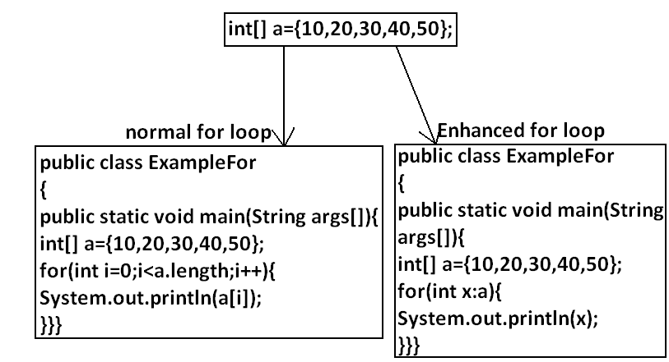
Example 1:
Write code to print the elements of single dimensional array by normal for loop and
enhanced for loop.
Example:
Output:
D:\Java>javac ExampleFor.java
D:\Java>java ExampleFor
10
20
30
40
50
105

Slide 45
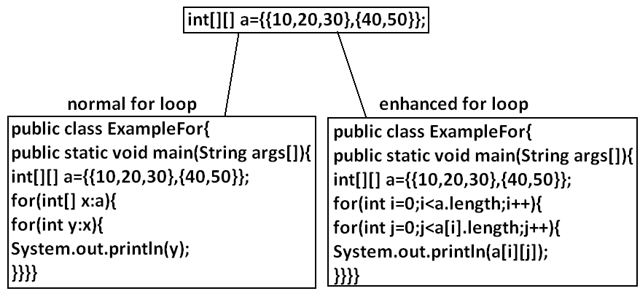
Example 2: Write code to print the elements of 2 dimensional arrays by using normal for loop and enhanced for loop.

Slide 46
Example 3:
Write equivalent code by For Each loop for the following for loop.
public class ExampleFor{
public static void main(String args[]){
for(int i=0;i<10;i++)
{
System.out.println("hello");
}}}
Output:
D:\Java>javac ExampleFor1.java
D:\Java>java ExampleFor1
Hello
Hello
Hello
Hello
Hello
Hello
Hello
Hello
Hello
Hello
We can't write equivalent for each loop.
▪ For each loop is the more convenient loop to retrieve the elements of arrays and
collections, but its main limitation is it is not a general purpose loop.
▪ By using normal for loop we can print elements either from left to right or from
right to left. But using for-each loop we can always print array elements only
from left to right.
106

Slide 47
Iterator Vs Iterable(1.5v)
•

Slide 48
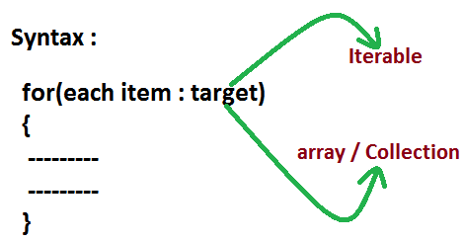
• The target element in for-each loop should be Iterable object.
• An object is set to be iterable iff corresponding class implements
java.lang.Iterable interface.
• Iterable interface introduced in 1.5 version and it's contains only one method
iterator().
Syntax : public Iterator iterator();
Every array class and Collection interface already implements Iterable interface.
107

Slide 49
Difference between Iterable and Iterator
Iterable | Iterator
It is related to forEach loop | It is related to Collection
The target element in forEach loop should be Iterable | We can use Iterator to get objects one by one from the collection
Iterator present in java.lang package | Iterator present in java.util package
contains only one method iterator() | contains 3 methods hasNext(), next(), remove()
Introduced in 1.5 version | Introduced in 1.2 version
107

Slide 50
Transfer statements

Slide 51
Example 1:
class Test{
public static void main(String args[]){
int x=0;
switch(x)
{
case 0:
System.out.println("hello");
break ;
case 1:
System.out.println("hi");
}
Output:
D:\Java>javac Test.java
D:\Java>java Test
Hello
Break statement:
We can use break statement in the following cases.
• Inside switch to stop fall-through.
• Inside loops to break the loop based on some condition.
• Inside label blocks to break block execution based on some condition.
Inside switch :
We can use break statement inside switch to stop fall-through
107

Slide 52
Inside loops :
We can use break statement inside loops to break the loop based on some condition.
Example 2:
class Test{
public static void main(String args[]){
for(int i=0; i<10; i++) {
if(i==5)
break;
System.out.println(i);
}
}}
Output:
D:\Java>javac Test.java
D:\Java>java Test
0
1
2
3
4
Inside Labeled block :
We can use break statement inside label blocks to break block execution based on some condition.
Example:
class Test{
public static void main(String args[]){
int x=10;
l1 : {
System.out.println("begin");
if(x==10)
break l1;
System.out.println("end");
}
System.out.println("hello");
}
}
Output:
D:\Java>javac Test.java
D:\Java>java Test
begin
hello
108

Slide 53
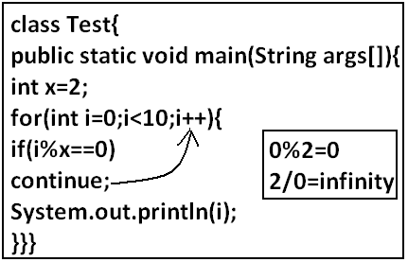
These are the only places where we can use break statement. If we are using anywhere else we will get compile time error.
Continue statement:
We can use continue statement to skip current iteration and continue for the next
iteration.
We can use continue only inside loops if we are using anywhere else we will get compile
time error saying "continue outside of loop".
Example:
class Test{
public static void main(String args[]){
int x=10;
if(x==10)
break;
System.out.println("hello");
}
}
Output:
Compile time error.
D:\Java>javac Test.java
Test.java:5: break outside switch or loop
break;
Output:
D:\Java>javac Test.java
D:\Java>java Test
1
3
5
7
9
108

Slide 54
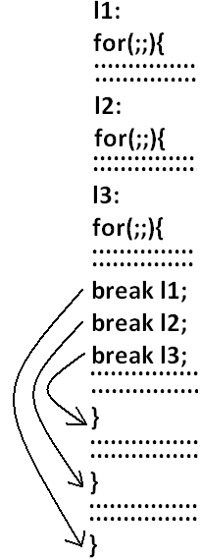
Example:
class Test
{
public static void main(String args[]){
int x=10;
if(x==10);
continue;
System.out.println("hello");
}
}
Output:
Compile time error.
D:\Enum>javac Test.java
Test.java:6: continue outside of loop
continue;
Syntax:
Labeled break and continue statements:
In the nested loops to break (or) continue a particular loop we should go for labeled
break and continue statements.

Slide 55
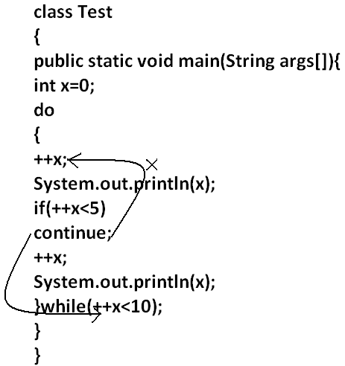
Example:
class Test
{
public static void main(String args[]){
l1:
for(int i=0;i<3;i++)
{
for(int j=0;j<3;j++)
{
if(i==j)
break;
System.out.println(i+"........."+j);
}
}
}
}
Break:
1.........0
2.........0
2.........1
Break l1:
No output.
Continue:
0.........1
0.........2
1.........0
1.........2
2.........0
2.........1
Continue l1:
1.........0
2.........0
Do-while vs continue (The most dangerous combination):
Output:
1
4
6
8
10

Slide 56
Compiler won't check unreachability in the case of if-else it will check only in loops.
Example 1:
class Test
{
public static void main(String args[]){
while(true)
{
System.out.println("hello");
}
System.out.println("hi");
}
}
Output:
Compile time error.
D:\Enum>javac Test.java
Test.java:8: unreachable statement
System.out.println("hi");
Example 2:
class Test
{
public static void main(String args[]){
if(true)
{
System.out.println("hello");
}
else
{
System.out.println("hi");
}}}
Output:
Hello

Slide 57
THANK YOU

